Slide 1
Docker

Slide 2
Contents
Fundamental of Docker
Container at a scale.
Benefits of docker
Docker can not solve.
Virtual machine and container
Docker concepts

Slide 3
Contents
Install docker
Docker hub
Docker images
Container life cycle
Executing command
Container management

Slide 4
Contents
Persistent storage
Logs and monitoring
Image management

Slide 5
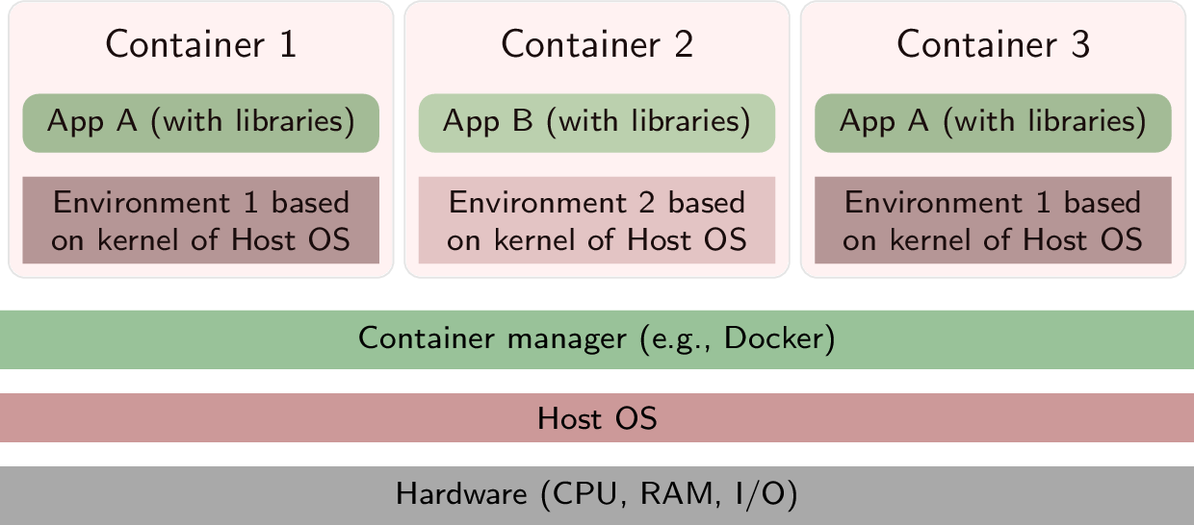
O/S Virtualization
levelup.gitconnected.com

Slide 6
Fundamental of docker
What is docker?
Set of services and tools help running and managing containers.
What is container?
Unit of s/w that packages up libraries, code and dependencies to run the application quickly, and reliable from one system to another. The container is a temporary, or ephemeral.

Slide 7
Fundamental of docker
What included in container?
System libraries
Programming language runtimes
Programming language libraries.
Configuration settings.
Static data files.

Slide 8
Container at a scale
The platform must ensure availability of container.
Must respond to application spikes by increasing/decreasing the running containers.
Use a load balancing techniques.
React according to failure of container, or container host.
Automated workflow to deliver new application in transparent and secure way.
Kubernetes is an orchestration layer.

Slide 9
Benefits of docker
Main benefits
More efficient use of system resources | Less memory than VM Saves costs of s/w licenses. Process isolation.
Faster software delivery cycles | Easy scaling to meet demand Easy to put new versions of s/w Quickly roll-back to previous version Easy to implement blue/green deployments.
Application portability | Because of encapsulation, Allow applications to be shuttled easily between environments. Any host running docker runtime can run the container
Shine for microservices architecture | No single point of failure. Perfect suited to the microservices approach .
Scalability | Can scale out based on load using orchestration layer like kubernetes
Speed | Startup, and stop more quickly
Notes:
No Single point of failure — We’ve all been in that situation where an error in a tiny function crashes an entire application with functionalities not even related to it i.e., Single point of failure. Docker helps you in preventing this situation. You can break a huge monolithic app into multiple microservices, helping you with easier deployments.
Scalability — Containers are quickly scalable with the help of orchestration services like Kubernetes or swarm that helps it in creating and destroying multiple copies of containers very fast. Scalability — Containers are quickly scalable with the help of orchestration services like Kubernetes or swarm that helps it in creating and destroying multiple copies of containers very fast.
Isolation on os level
Ease of use: Docker has made it much easier for anyone — developers, systems admins, architects and others — to take advantage of containers in order to quickly build and test portable applications. It allows anyone to package an application on their laptop, which in turn can run unmodified on any public cloud, private cloud, or even bare metal. The mantra is: “build once, run anywhere.”

Slide 10
Docker don’t solve
Docker don’t solve?
Fix your security issues.
Does not turn your application into microservices.
Is not substitute of VMs.

Slide 11
Virtual machine and container
Virtual machine and container?
Virtual machine | Container
Multiple OS run side by side | Run directly on the OS, sharing hardware and OS across all containers.
Hypervisor to divide hardware into virtual hardware system | Share the same SO, isolate the containerized application processes from the rest of the system.
Require a complete OS | Require less hardware resources.

Slide 12
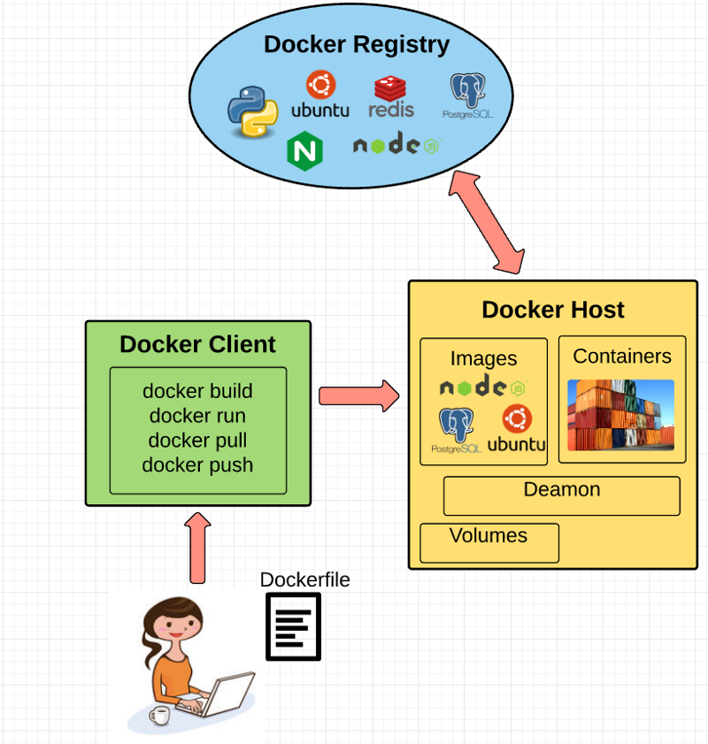
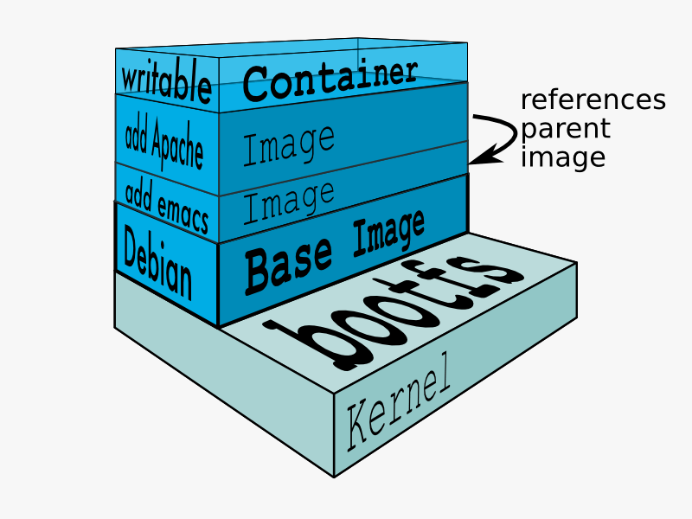
Docker concepts
Docker Engine
Docker client
Docker daemon
Docker file
Docker image
Union file system
Volumes
Docker containers
From docker
www.freecodecamp.org

Slide 13
Install
sudo apt install apt-transport-https ca-certificates curl software-properties-common
curl -fsSL https://download.docker.com/linux/ubuntu/gpg | sudo apt-key add --
sudo add-apt-repository "deb [arch=amd64] https://download.docker.com/linux/ubuntu focal stable“
sudo apt update
sudo apt-get install docker-ce docker-ce-cli containerd.io

Slide 14
Docker hub
To login to docker hub
$sudo docker login
To get an image: docker pull <image name>:<tag>
$sudo docker pull ubuntu
To search for an image: docker search <image>
$sudo docker search ubuntu
Logout: docker logout
$sudo docker logout

Slide 15
Docker images
To list all images:
$sudo docker images
To remove an image: docker rmi <image>
$sudo docker rmi ubuntu
To display a container information: docker inspect <image>
$sudo docker inspect ubuntu

Slide 16
Container life cycle
To list all running containers: docker ps-a
$sudo docker ps -a
Create a container from docker image: docker run <options> <image name>
-t:Terminal, -d: Daemon, -p <host port>:<container port>, --name <container name>,--ip <ip>, -e VAR=VALUE
$sudo docker run –td –p 81:80 –name myweb ubuntu
To build a docker image: docker build <Directory of Dockerfile>/ -t <image name>
$sudo docker build MyDockerfiledir/ -t HostingServer

Slide 17
Executing command
To execute a command : docker exec <options> <container> <command>
$sudo docker exec –it myweb bash

Slide 18
Container management
To stop a container: docker stop <container>
$sudo docker stop mytest
To start a stopped container: docker start <container>
$sudo docker start mytest
To remove a stopped container: docker rm <container>
$sudo docker rm mytest
To copy files/directory: docker cp <src> <container>:<dest> or docker cp <container>:<src> <dest>
$sudo docker cp /tmp/myfile mytest:/tmp
To display information about container: docker inspect <container>
$sudo docker inspect myweb1

Slide 19
Persistent storage
Containers are temporary and ephemeral
Persistent storage is an external storage that mounted to a directory inside the container
4 types of persistent storage
Volumes: Stored as a part of docker host file system. Should not be modified outside container.. Created under /var/lib/docker/volumes. Volume drivers allowing storing data to remote hosts.
Bind: A directory on docker host. Can be modified outside container.
Tmpfsmounts. Stored in the host memory.
Named pipe: Used for communication between docker host and the container.

Slide 20
Persistent storage (contd)
To create a volume: docker volume create <volme name>
$sudo docker volume create mydb
To list configured volumes
$sudo docker volume ls
To remove a volume: docker volume rm <volume>
$sudo docker volume rm mydb
To display information about a volume: docker volume inspect <volume>
$sudo docker volume inspect mydb

Slide 21
Persistent storage (contd)
To start a container with volume: docker run with mount options
--mount type=volume,src=<volume>,dst=<container directory>
$sudo docker run –td –name myweb1 –mount type=volume,src=mydb,dst=/koko ubuntu
To start a container with bind options: docker run with mount options
--mount type=bind,src=<docker host dir>,dst=<container directory>
$sudo docker run –td –name myweb1 –mount type=volume,src=/hd,dst=/koko ubuntu

Slide 22
Logs and monitoring
To check resource usage: docker stats
$sudo docker stats
To debug events:: docker events
$sudo docker events
To display running processes: docker top <container>
$sudo docker top myweb1
To display container logs: docker logs <container>
$sudo docker logs myweb1

Slide 23
Image management
Use a Dockerfile : docker build <Directory>/ -t <image name>
$sudo docker build MynewWeb/ -t mynewimage
To create an image for apache based on ubuntu:
Create a file called Dockerfile
FROM ubuntu:latest
LABEL maintainer=compiler@aast.edu
RUN apt update
RUN apt install apache2 –y
CMD ["/usr/sbin/apache2ctl", "-DFOREGROUND"]

